Slide 1
Unit 5 Series Circuits
Part B: Laws and Rules Governing Series Circuits

Slide 2
What will you learn?
What a circuit node is
What a circuit loop is
Kirchhoff’s Voltage Law
Equivalent or total resistance
Voltage Divider Rule
Relationship of the power delivery and power dissipation of the circuit components.

Slide 3
What is a node in a circuit?
In a given electrical circuit, there are connecting points where elements meet.
The circuit here shows these meeting points as A, B, C and D.
A meeting point has same voltage level throughout.
Example: Node B is the meeting point for R₁, R₂, R₃ and R₄
Node D is the ground and is often not named.

Slide 4
What is a loop in a circuit?
A loop in an electrical circuit is a closed path that starts at a node, proceeds through some circuit elements (branches), and returns to the starting node.
A loop cannot pass through any node more than once.
Loop X & Y are valid loops.
But not Z which passes by Node B twice.
The circuit has 6 valid loops in total.

Slide 5
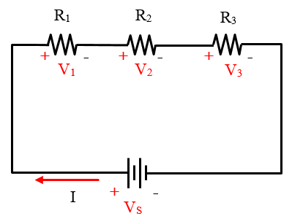
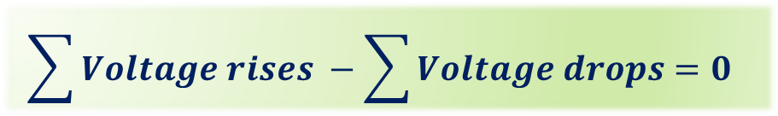

Kirchhoff’s Voltage Law (KVL)
Kirchhoff’s Voltage Law states that
The algebraic sum of all the voltages in a closed loop or circuit is zero
That is, if a voltage rise is considered positive, and a voltage drop is negative, then
$$\sum{Voltage rises} −\sum{Voltage drops=0}$$
Summation Sign: The total sum of …
$$V_{S}−V_{1}−V_{2}−V_{3}=0$$

Slide 6



Kirchhoff’s Voltage Law (KVL)
Alternatively KVL states that
The sum of all voltage rises equal to the sum of voltage drops
$$V_{S}−V_{1}−V_{2}−V_{3}=0$$
$$V_{S}=V_{1}+V_{2}+V_{3}$$
$$\sum{Voltage rises} =\sum{Voltage drops}$$
Summation Sign: The sum of …

Slide 7
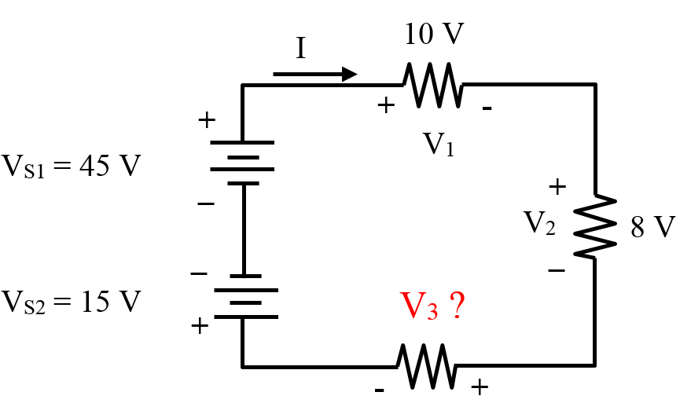
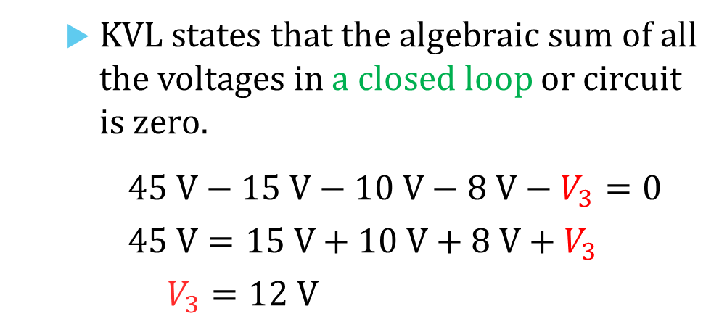
Example 1: Apply KVL to determine voltage drop V₃ in the circuit.
KVL states that the algebraic sum of all the voltages in a closed loop or circuit is zero.
$$45 V−15 V−10 V−8 V−V_{3}=0$$
$$45 V=15 V+10 V+8 V+V_{3}$$
$$V_{3}=12 V$$
A
B
E
D
C

Slide 8




Equivalent Resistance in Series Connection
Recall Ohm’s Law: Voltage drop across a resistor is equal to the current flowing through the resistor × the resistance of the resistor.
$$V=I×R$$
_
$$I$$
+
$$V$$
$$R$$

Slide 9
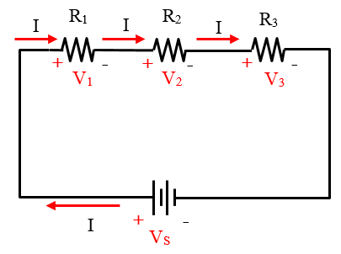



Equivalent Resistance in Series Connection
When there are more resistances connected in the circuit,
applying Ohm’s Law to each resistance yields the following voltage drops:
$$V_{1}=I×R_{1}$$
$$V_{2}=I×R_{2}$$
$$V_{3}=I×R_{3}$$

Slide 10
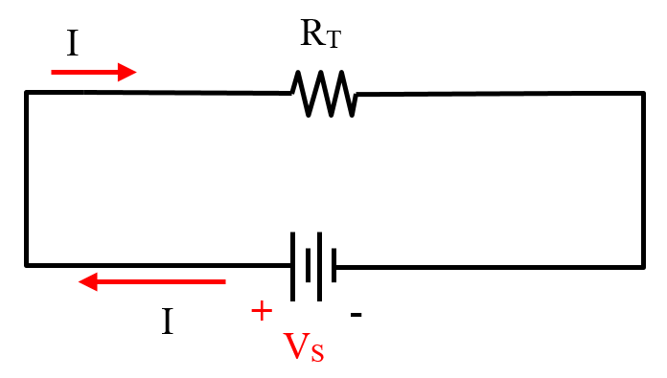
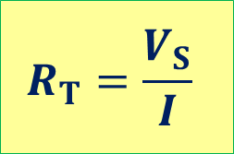


Equivalent Resistance in Series Connection
Apply KVL to the circuit.
$$V_{S}=V_{1}+V_{2}+V_{3}$$
$$=(I×R_{1})+(I×R_{2})+(I×R_{3})$$
$$=I(R_{1}+R_{2}+R_{3})$$
Let $R_{T}=R_{1}+R_{2}+R_{3}$ be the total resistance or equivalent resistance, then
$$R_{T}=\frac{V_{S}}{I}$$

Slide 11


Equivalent Resistance in Series Connection
In general, the equivalent resistance is the sum of all resistances connected in series.
where n is the total number of resistances.
$${R_{T}=R}_{1}+R_{2}+R_{3}+⋯+R_{n}$$
If all n resistances are of the same value R, then the equivalent resistance is
$$R_{T}=n×R$$

Slide 12
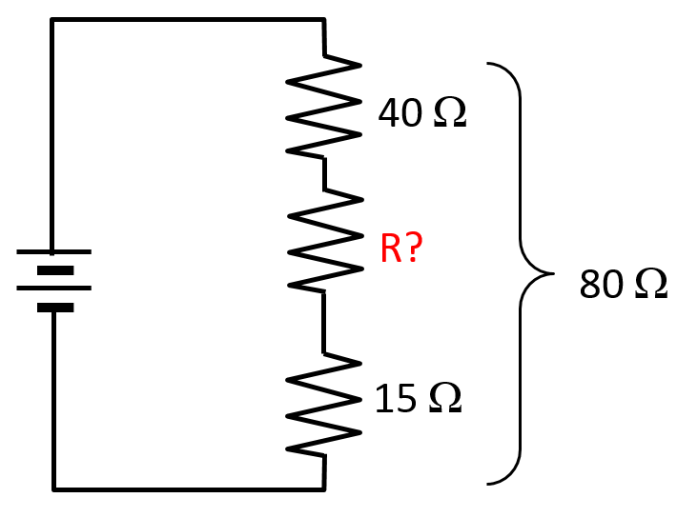

Example 2: Determine resistance R in the circuit.
The total resistance R_{T} is given as 80 Ω.
$$R=R_{T}−40−15$$
$$=80 −40 −15$$
$$=25 Ω$$

Slide 13
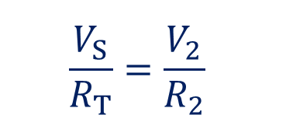
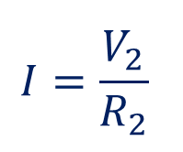
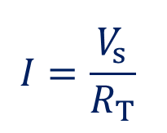
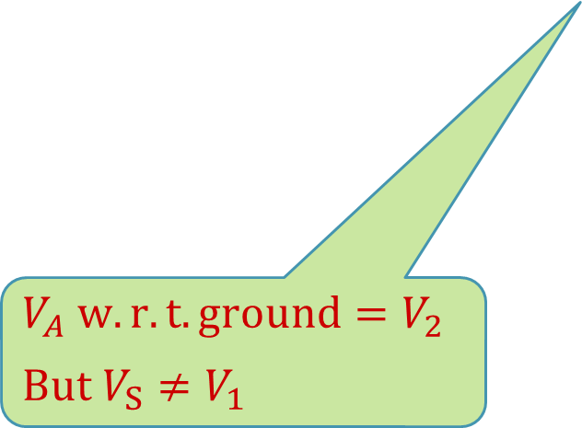
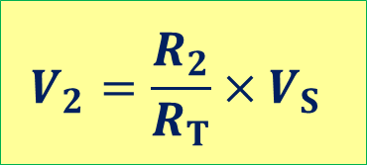
Voltage Divider Rule (VDR)
By Ohm’s Law,
$$I=\frac{V_{s}}{R_{T}}$$
$$I=\frac{V_{2}}{R_{2}}$$
and
Therefore
$$\frac{V_{S}}{R_{T}}=\frac{V_{2}}{R_{2}}$$
VDR:
$$V_{2}=\frac{R_{2}}{R_{T}}×V_{S}$$
$$V_{A} w.r.t. ground=V_{2}$$
$$But V_{S}≠V_{1}$$

Slide 14
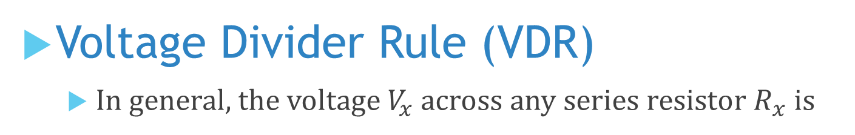
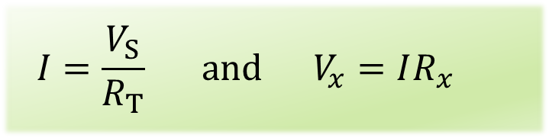
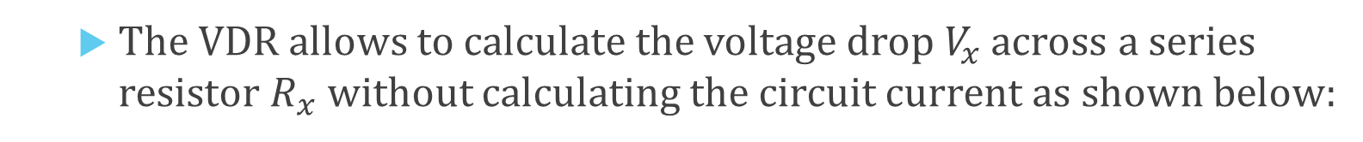
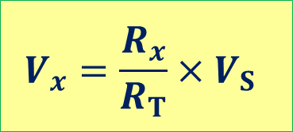
Voltage Divider Rule (VDR)
In general, the voltage $V_{x}$ across any series resistor $R_{x}$ is
$$V_{x}=\frac{R_{x}}{R_{T}}×V_{S}$$
The VDR allows to calculate the voltage drop $V_{x}$ across a series resistor $R_{x}$ without calculating the circuit current as shown below:
$$I=\frac{V_{S}}{R_{T}} and V_{x}=IR_{x}$$

Slide 15
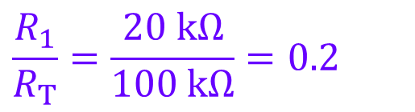
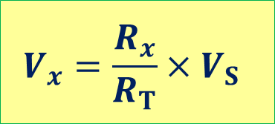
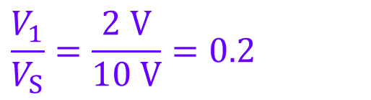


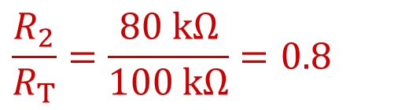
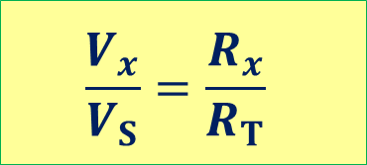
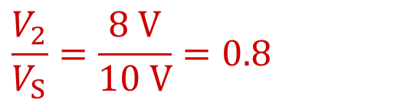
$$V_{x}=\frac{R_{x}}{R_{T}}×V_{S}$$
Voltage Divider Rule (VDR)
Voltage is divided among the components in a series circuit based on the ratio of individual resistance to total resistance.
$$\frac{V_{x}}{V_{S}}=\frac{R_{x}}{R_{T}}$$
$$R_{1}$$
+
_
$$\frac{R_{1}}{R_{T}}=\frac{20 kΩ}{100 kΩ}=0.2$$
$$\frac{V_{1}}{V_{S}}=\frac{2 V}{10 V}=0.2$$
2 V
20 kΩ
+
_
10 V
+
_
$$\frac{R_{2}}{R_{T}}=\frac{80 kΩ}{100 kΩ}=0.8$$
$$\frac{V_{2}}{V_{S}}=\frac{8 V}{10 V}=0.8$$
$$R_{2}$$
8 V
80 kΩ

Slide 16
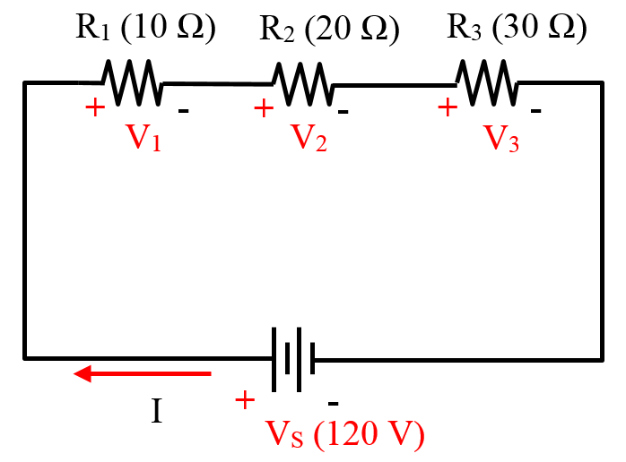


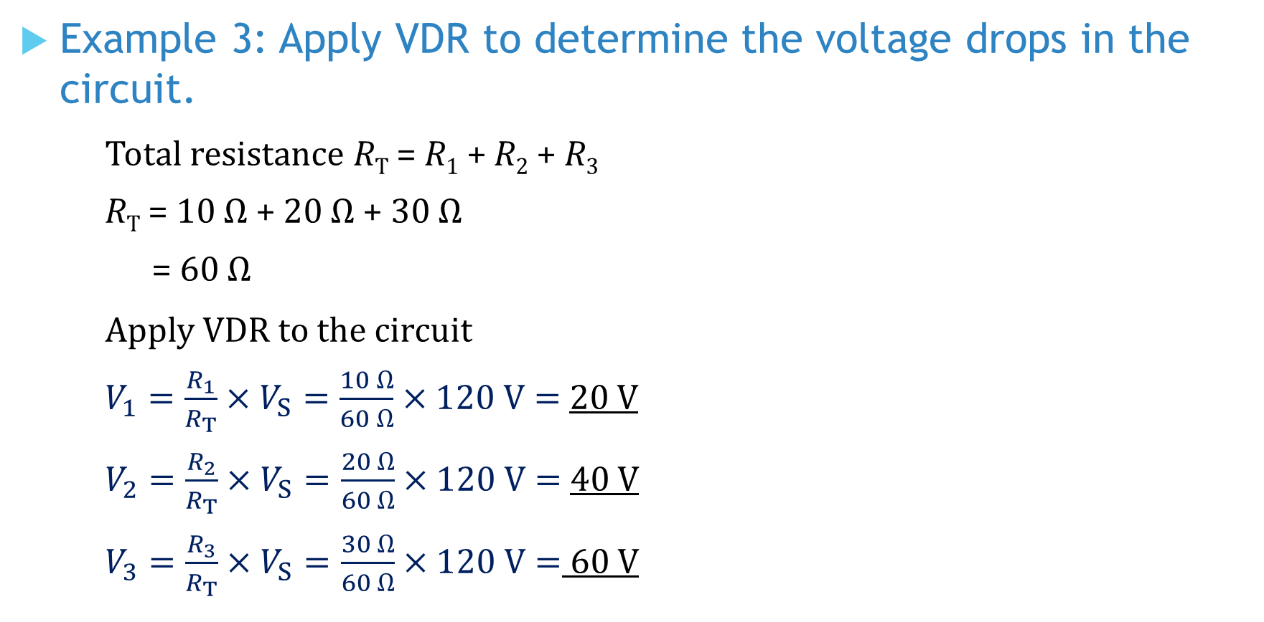
Example 3: Apply VDR to determine the voltage drops in the circuit.
Total resistance R_{T} = R₁ + R₂ + R₃
R_{T} = 10 Ω + 20 Ω + 30 Ω
= 60 Ω
Apply VDR to the circuit
$V_{1}=\frac{R_{1}}{R_{T}}×V_{S}=\frac{10 Ω}{60 Ω}×120 V=$20 V
$V_{2}=\frac{R_{2}}{R_{T}}×V_{S}=\frac{20 Ω}{60 Ω}×120 V=$40 V
$V_{3}=\frac{R_{3}}{R_{T}}×V_{S}=\frac{30 Ω}{60 Ω}×120 V=$ 60 V

Slide 17



Power dissipated in a series circuit
The total amount of power dissipated P_{T} in a series circuit is the sum of all individual amount of power dissipated.
where P₁, P₂, P₃ are individual power dissipated.
The power delivered from the source P_{S} is the product of source voltage V_{S} and source current I.
In a closed circuit, the power supplied is equals to total power dissipated in the circuit.
$$P_{T}=P_{1}+P_{2}+P_{3}$$
$$P_{S}=V_{S}×I$$
$$P_{S}=P_{T}$$

Slide 18


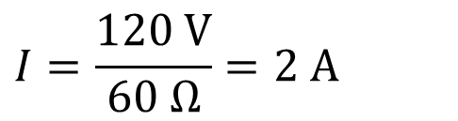
Example 4: (a) Calculate the power dissipation of each resistor. (b) Calculate the total power delivered from the voltage source.
$$\left(a\right) R_{T}=10+20+30=60 Ω$$
$$I=\frac{120 V}{60 Ω}=2 A$$
$$P_{1}=I^{2}R_{1}=2^{2}×10=40 W$$
$$P_{2}=I^{2}R_{2}=2^{2}×20=80 W$$
$$P_{3}=I^{2}R_{3}=2^{2}×30=120 W$$
$$\left(b\right) Total power delivered from the voltage source =V_{S}I=120×2=240 W$$
$$Alternatively$$
$$Total power delivered=Total power dissipated$$
$$=P_{1}+P_{2}+P_{3}=240 W$$

Slide 19
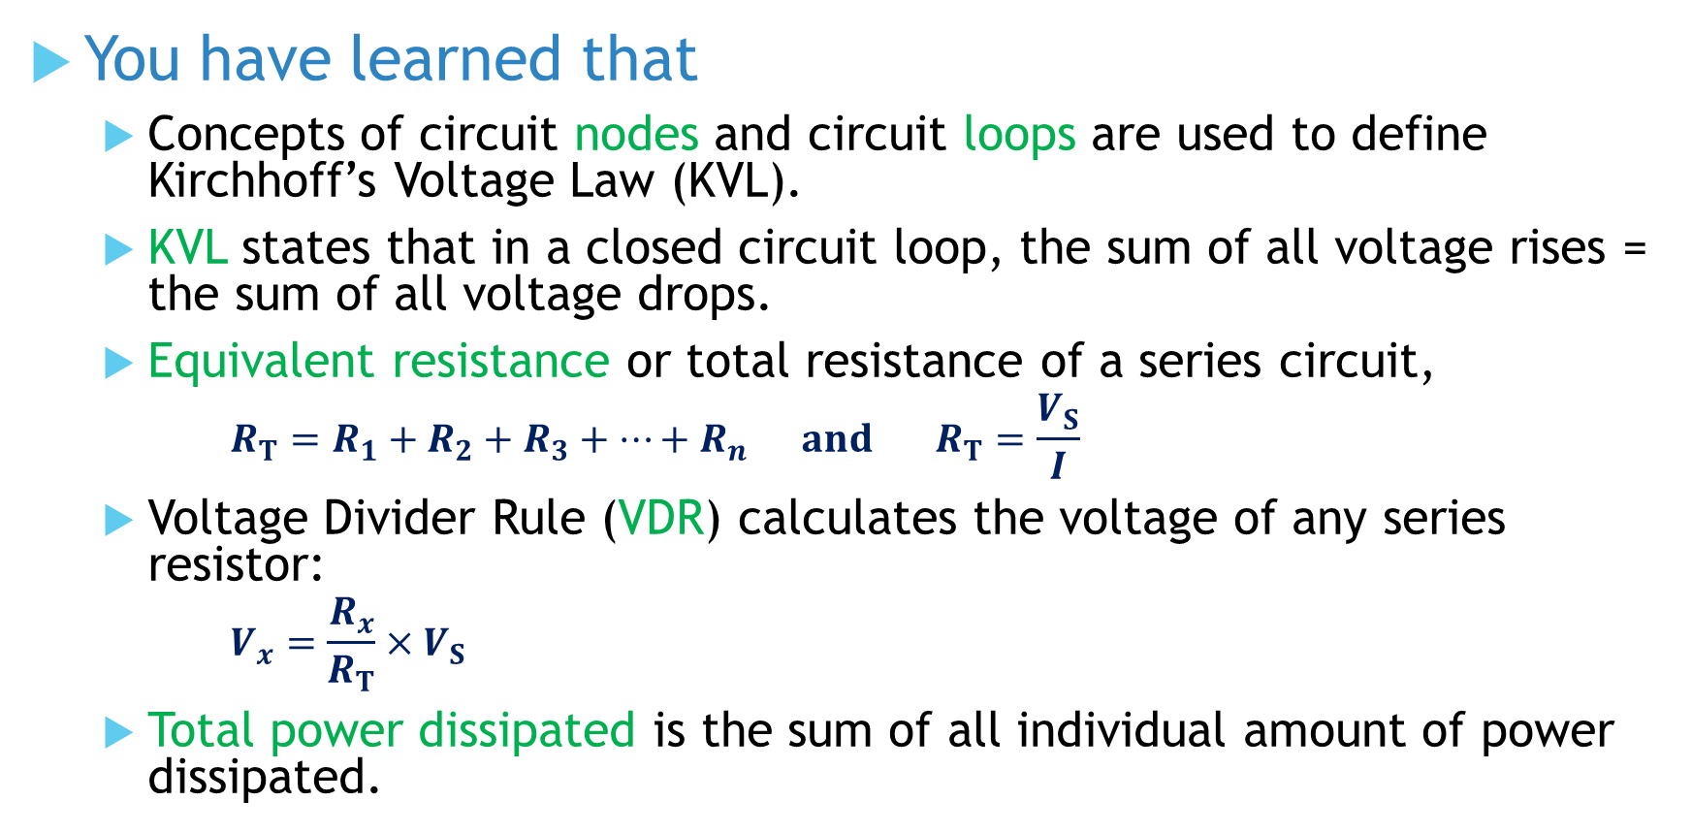
You have learned that
Concepts of circuit nodes and circuit loops are used to define Kirchhoff’s Voltage Law (KVL).
KVL states that in a closed circuit loop, the sum of all voltage rises = the sum of all voltage drops.
Equivalent resistance or total resistance of a series circuit,
$${R_{T}=R}_{1}+R_{2}+R_{3}+⋯+R_{n} and R_{T}=\frac{V_{S}}{I}$$
Voltage Divider Rule (VDR) calculates the voltage of any series resistor:
$$V_{x}=\frac{R_{x}}{R_{T}}×V_{S}$$
Total power dissipated is the sum of all individual amount of power dissipated.

Slide 20
Coming Up Next
Analysis of Series Circuits

